Slide 1
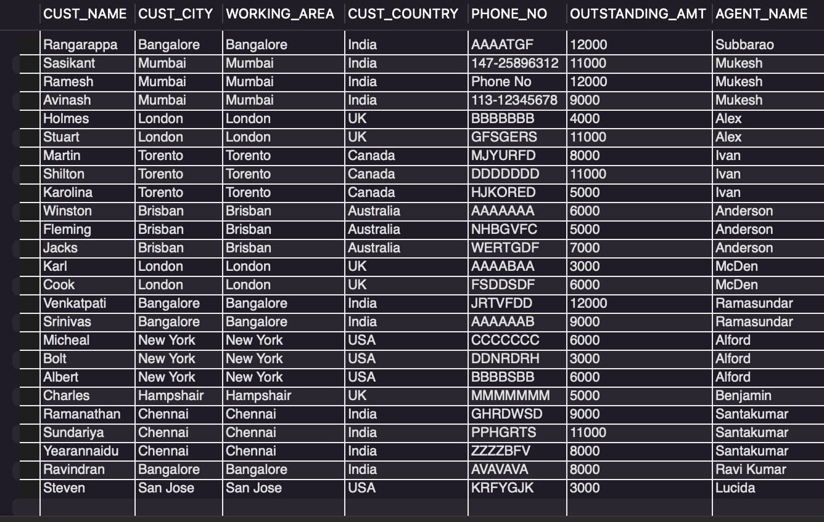
Q1. Retrieve customer details along with the agent's name who helped them, showing the total outstanding amount.
SELECT t1.CUST_NAME,t1.CUST_CITY,t1.WORKING_AREA,t1.CUST_COUNTRY,t1.PHONE_NO,t1.OUTSTANDING_AMT,t2.AGENT_NAME
FROM customer AS t1
JOIN agents AS t2
ON t1.AGENT_CODE = t2.AGENT_CODE;

Slide 2
Q1 - Insights (SQL Breakdown)
Uses an INNER JOIN between customer and agents tables.
Join condition: matching AGENT_CODE in both tables.
Selects customer details along with corresponding agent name.
Includes OUTSTANDING_AMT to show financial details per customer.

Slide 3
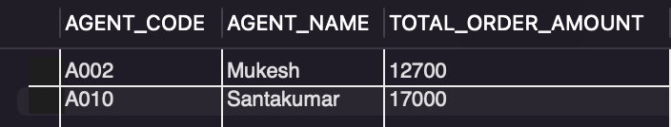
Q2. Find the agents whose total order amount exceeds 10,000.
SELECT a.AGENT_CODE,a.AGENT_NAME,SUM(o.ORD_AMOUNT) AS TOTAL_ORDER_AMOUNT
FROM agents AS a
JOIN orders AS o
ON a.AGENT_CODE = o.AGENT_CODE
GROUP BY a.AGENT_CODE
HAVING SUM(o.ORD_AMOUNT) > 10000;

Slide 4
Q2 - Insights (SQL Breakdown)
Joins agents and orders tables on AGENT_CODE.
Uses SUM(ORD_AMOUNT) to calculate total sales per agent.
Groups data by AGENT_CODE for aggregation.
HAVING clause filters agents with sales > 10,000.

Slide 5
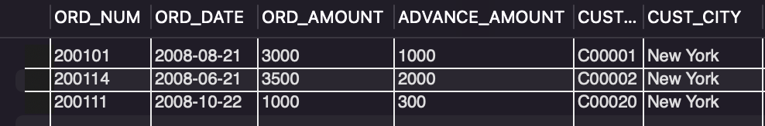
Q3. Find all orders placed by customers who reside in New York.
SELECT o.ORD_NUM,o.ORD_DATE,o.ORD_AMOUNT,o.ADVANCE_AMOUNT,c.CUST_CODE,c.CUST_CITY
FROM Orders o
JOIN customer c ON o.CUST_CODE = c.CUST_CODE
WHERE c.CUST_CITY = 'New York';

Slide 6
Q3 - Insights (SQL Breakdown)
Performs INNER JOIN between orders and customer tables.
Join condition: matching CUST_CODE in both tables.
Filters results with WHERE clause on CUST_CITY = 'New York'.
Selects order details specifically for New York customers.

Slide 7
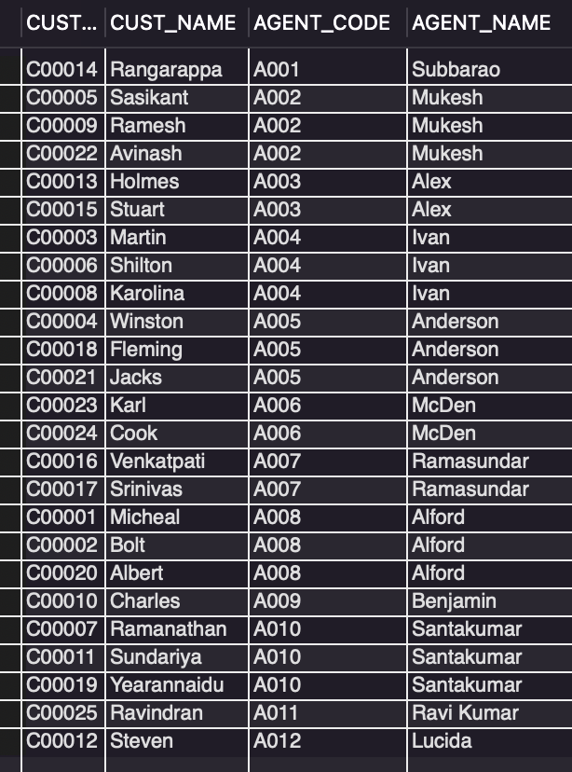
Q4. Retrieve customer details along with the agent's name who helped them.
SELECT c.CUST_CODE,c.CUST_NAME,a.AGENT_CODE,a.AGENT_NAME
FROM customer c
JOIN agents a ON c.AGENT_CODE = a.AGENT_CODE;

Slide 8
Q4 - Insights (SQL Breakdown)
Uses an INNER JOIN between customer and agents tables.
Join condition: matching AGENT_CODE between the two tables.
Selects customer code and name with agent code and name.
Shows direct link between each customer and their agent.

Slide 9
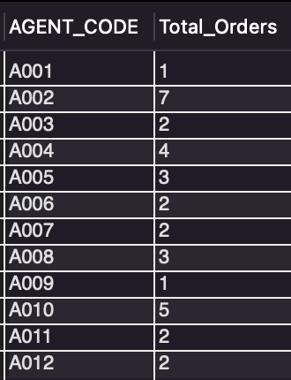
Q5. Find the total number of orders handled by each agent.
SELECT AGENT_CODE,COUNT(ORD_NUM) AS Total_Orders
FROM orders
GROUP BY AGENT_CODE;

Slide 10
Q5 - Insights (SQL Breakdown)
Queries the orders table only.
Counts number of orders (ORD_NUM) handled by each agent.
Groups results by AGENT_CODE.
Displays workload of each agent in terms of orders handled.

Slide 11
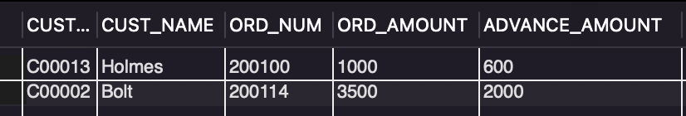
Q6. Get the list of customers who placed an order with an advance amount greater than or equal to 50% of the order amount.
SELECT c.CUST_CODE,c.CUST_NAME,o.ORD_NUM,o.ORD_AMOUNT,o.ADVANCE_AMOUNT
FROM customer c
JOIN orders o ON c.CUST_CODE = o.CUST_CODE
WHERE o.ADVANCE_AMOUNT >= 0.5 * o.ORD_AMOUNT;

Slide 12
Q6 - Insights (SQL Breakdown)
Joins customer and orders tables using CUST_CODE.
Applies condition on ADVANCE_AMOUNT >= 50% of ORD_AMOUNT.
Retrieves details of customers and their qualifying orders.
Highlights customers who paid large advances upfront.

Slide 13
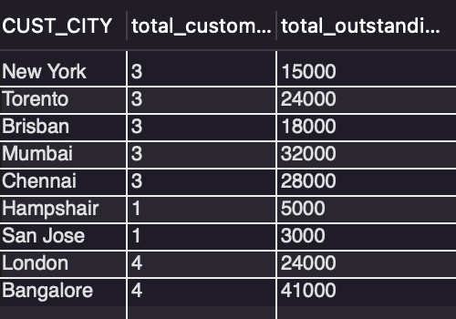
Q7. Find the number of customers in each city and the total outstanding amount for each city.
SELECT CUST_CITY,COUNT(CUST_CODE) AS total_customer,SUM(OUTSTANDING_AMT) AS total_outstanding
FROM customer
GROUP BY CUST_CITY;

Slide 14
Q7 - Insights (SQL Breakdown)
Groups customer data by CUST_CITY.
Counts number of customers in each city.
Calculates total outstanding amount per city.
Useful for city-wise customer and financial distribution.

Slide 15
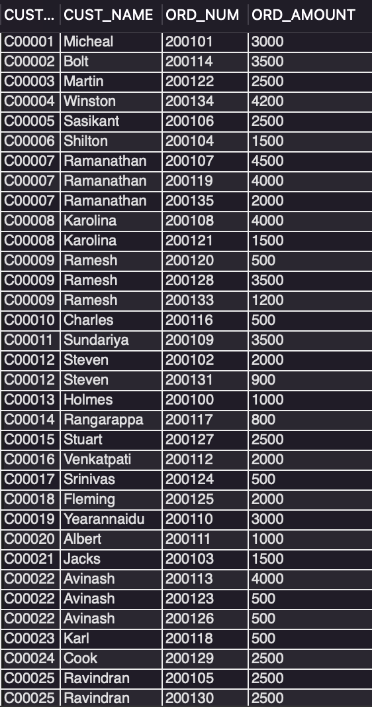
Q8. List all customers along with their orders, including customers who have not placed any orders.
SELECT c.CUST_CODE,c.CUST_NAME,o.ORD_NUM,o.ORD_AMOUNT
FROM Customer c
LEFT JOIN Orders o ON c.CUST_CODE = o.CUST_CODE;

Slide 16
Q8 - Insights (SQL Breakdown)
Uses LEFT JOIN between customer and orders tables.
Ensures all customers are included, even without orders.
Join condition: matching CUST_CODE in both tables.
Displays order details where available, otherwise NULL.

Slide 17

Q9. Find the customer who placed the highest order amount using a subquery.
SELECT c.CUST_NAME,c.CUST_CODE,o.ORD_NUM,o.ORD_AMOUNT
FROM Orders as o
JOIN customer as c
ON o.CUST_CODE=c.CUST_CODE
WHERE ORD_AMOUNT = (SELECT MAX(ORD_AMOUNT) FROM Orders);

Slide 18
Q9 - Insights (SQL Breakdown)
Uses a subquery to find MAX(ORD_AMOUNT).
Joins orders with customer table using CUST_CODE.
Filters records where order amount matches the maximum.
Displays customer and order details of the highest order.

Slide 19
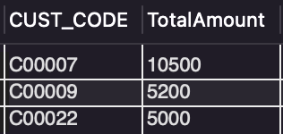
Q10. Find the total order amount for customers who have placed more than 2 orders using a subquery.
SELECT CUST_CODE, SUM(ORD_AMOUNT) AS TotalAmount
FROM Orders
WHERE CUST_CODE IN (
SELECT CUST_CODE
FROM Orders
GROUP BY CUST_CODE
HAVING COUNT(ORD_NUM) > 2
)
GROUP BY CUST_CODE;

Slide 20
Q10 - Insights (SQL Breakdown)
Subquery with GROUP BY & HAVING → The subquery groups orders by CUST_CODE and selects only those customers who have placed more than 2 orders.
IN condition → The main query filters only those CUST_CODEs that appear in the subquery result (i.e., customers with >2 orders).
SUM aggregation → For each selected customer, the query calculates the total order amount using SUM(ORD_AMOUNT).
Final result → The output gives a list of customers (CUST_CODE) along with their cumulative order amount, but only for those who are frequent buyers (more than 2 orders).

Slide 21
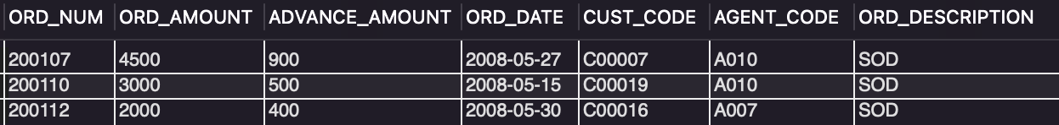
Q11. List the orders placed in the month of May 2008.
SELECT *
FROM Orders
WHERE ORD_DATE BETWEEN '2008-05-01' AND '2008-05-31';

Slide 22
Q11 - Insights (SQL Breakdown)
Queries orders table directly.
Uses WHERE clause with date range filter.
Retrieves orders placed between '2008-05-01' and '2008-05-31'.
Focuses only on May 2008 order data.

Slide 23
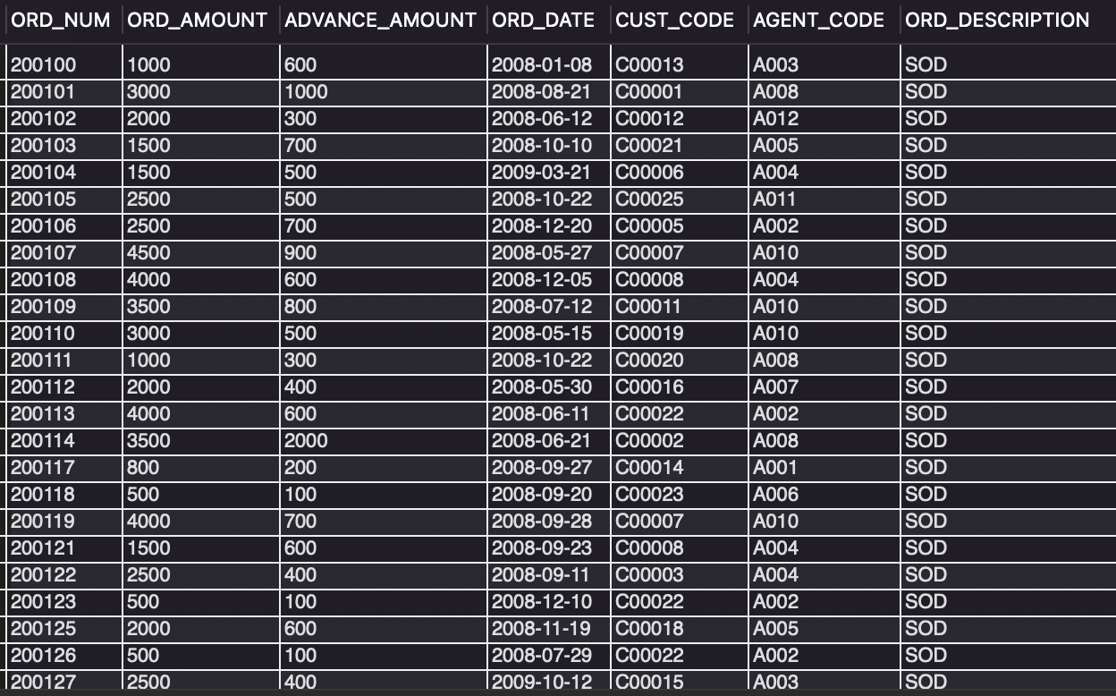
Q12. List orders where the amount is greater than 1000 or the order date is before '2008-12-31'.
SELECT *
FROM Orders
WHERE ORD_AMOUNT > 1000 OR ORD_DATE < '2008-12-31';

Slide 24
Q12 - Insights (SQL Breakdown)
Queries orders table directly.
Uses WHERE clause with OR condition.
Filters orders with amount > 1000 or date < '2008-12-31'.
Covers two different filtering scenarios in one query.

Slide 25
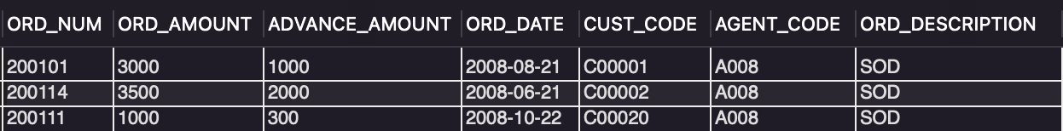
Q13. Find all orders placed by customers in 'New York' or whose order amount is greater than 5000.
SELECT o.*
FROM Orders o
JOIN Customer c ON o.CUST_CODE = c.CUST_CODE
WHERE c.CUST_CITY = 'New York' OR o.ORD_AMOUNT > 5000;

Slide 26
Q13 - Insights (SQL Breakdown)
Joins orders and customer tables using CUST_CODE.
Uses WHERE clause with OR condition.
Retrieves orders for customers in 'New York' OR with ORD_AMOUNT > 5000.
Shows flexibility with multiple filter conditions.

Slide 27

Q14. Find the agents who have handled orders for more than 3 distinct customers.
SELECT AGENT_CODE,COUNT(DISTINCT CUST_CODE) AS CustomersHandled
FROM Orders
GROUP BY AGENT_CODE
HAVING COUNT(DISTINCT CUST_CODE) > 3;

Slide 28
Q14 - Insights (SQL Breakdown)
Groups orders by AGENT_CODE.
Uses COUNT(DISTINCT CUST_CODE) to count unique customers.
HAVING clause filters agents with more than 3 customers.
Identifies agents with wider customer coverage.

Slide 29
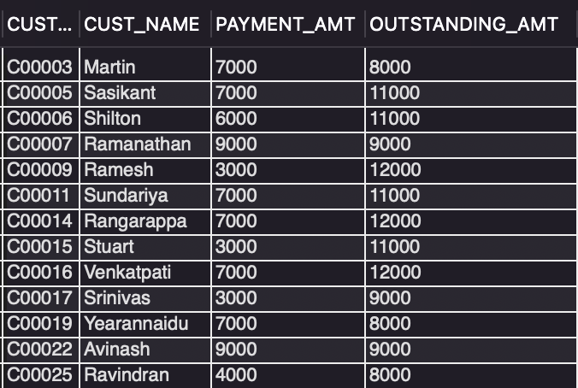
Q15. Find customers who have made at least one payment but still have an outstanding amount greater than 7000.
SELECT c.CUST_CODE,c.CUST_NAME,c.PAYMENT_AMT,c.OUTSTANDING_AMT
FROM Customer c
WHERE c.PAYMENT_AMT > 0 AND c.OUTSTANDING_AMT > 7000;

Slide 30
Q15 - Insights (SQL Breakdown)
Queries customer table directly.
Applies condition where PAYMENT_AMT > 0 (at least one payment).
Adds condition where OUTSTANDING_AMT > 7000.
Finds customers still owing large balances despite payments.

